Slide 1

AMCAT Data: Analyzing Employment Trends and Skill Demand
Presented By:
Mohammed Khaja Moinuddin

Slide 2
Objective
The objective of the AMCAT Data Analysis test is to evaluate a candidate's ability to interpret and analyze data, identify trends, and derive insightful conclusions. It measures proficiency in working with datasets, applying statistical techniques, and using data visualization tools to communicate findings effectively.

Slide 3
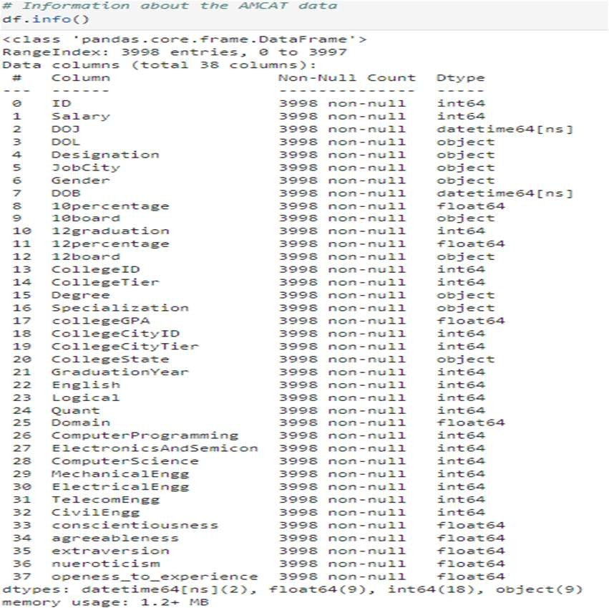
Summary of Data
Total Records: 3998 rows with 38 columns capturing candidate information.
Key Features: Salary, Designation, Gender, Job City, and Graduation Year.
Academic Data: Includes 10percentage, 12percentage, college GPA, and specialization details.
Technical Skills: Scores in Computer Programming,
Electronics, Mechanical, and other engineering domains.
Personality Traits: Measures of conscientiousness, agreeableness, extraversion, neuroticism,and openness to experience

Slide 4
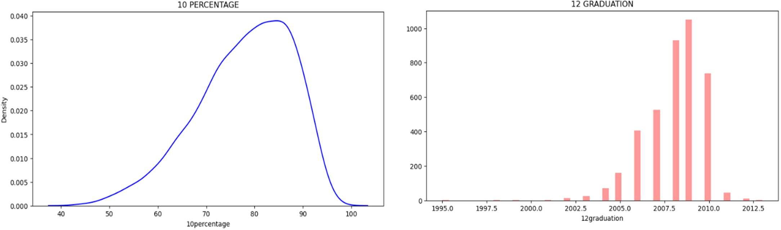
Univariate Analysis
Insights
THE MOST OF 10TH PERCENTAGE ARE RANGE BETWEEN 60 TO 95.
THE MOST OF THE 12TH GRADUATION ARE FROM 2009 and 2008.
THE LEAST ARE FROM 2001,1995,1998,2013 and 1999.

Slide 5
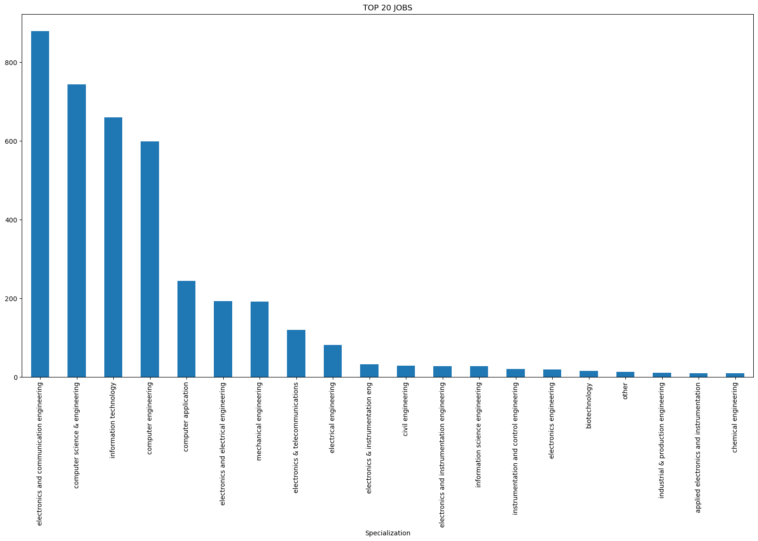
Univariate Analysis
Insights
Insights
The chart shows that Electronics and Communication Engineering (ECE) has the highest job opportunities, followed by tech-related fields like Computer Science & Engineering and Information Technology. Traditional engineering fields like Mechanical and Electrical Engineering also have significant demand, though tech dominates the job market.

Slide 6
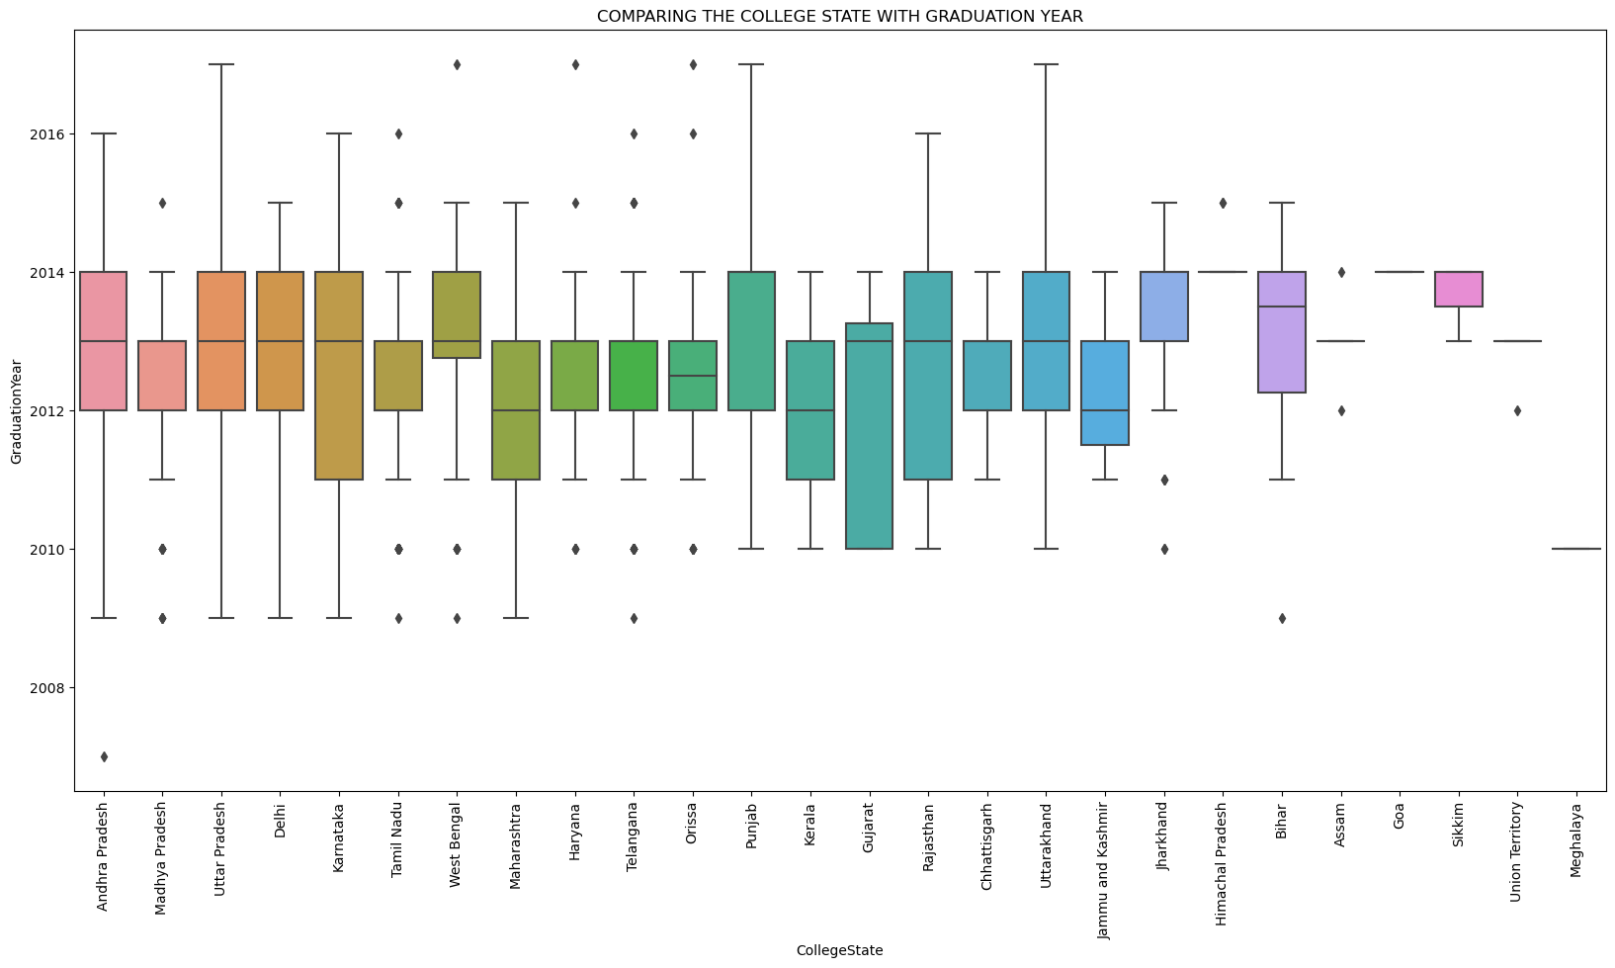
Comaring The college with Graduation year

Slide 7
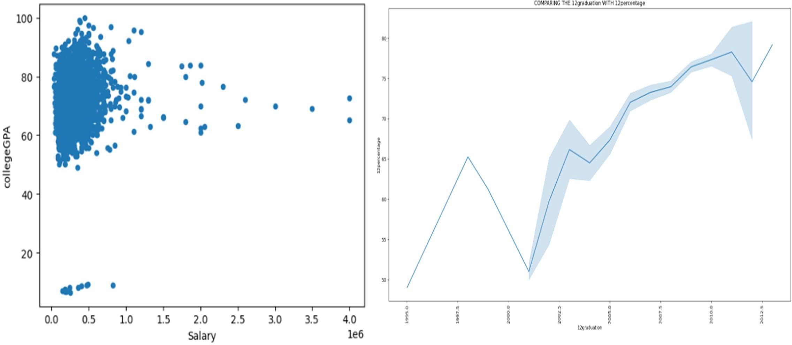
Bivariate Analysis

Slide 8
Observations
Salary Distribution: Average salaries vary significantly across different job roles, with higher pay observed
for technical positions such as Software Engineer and Programming Analyst.
Specialization Impact: Graduates with Computer Science and IT specializations generally
receive higher compensation compared to other fields, indicating a strong demand for tech-related skills.
Gender Disparity: There is an uneven gender distribution, with male candidates outnumbering
females in most technical roles, suggesting a potential gender imbalance.
College Tier Influence: Graduates from Tier 1 colleges tend to have higher starting salaries compared to
Tier 2 and Tier 3 college graduates, showing the impact of institutional reputation.
Skills Correlation: Technical and analytical skills like programming, along with behavioral traits such as
conscientiousness, are positively correlated with higher salaries and job placements.

Slide 9
Conclusion
The AMCAT dataset offers critical insights into employment patterns, salary distributions, and the influence of academic backgrounds and skillsets on the career trajectories of fresh graduates. By thoroughly analyzing this data, companies can identify emerging, high-demand specializations and competencies, enabling them to enhance their recruitment strategies effectively. Moreover, the dataset serves as a benchmarking tool for educational institutions, helping them to tailor their curricula to meet evolving industry demands. Insights on gender representation and salary inequalities can further support the creation of policies aimed at fostering a more diverse and inclusive workforce in the future. Through these combined efforts, both industries and academia can work in tandem to shape a more equitable and competitive job market.

Slide 10
Thank You!

